Slide 1
Azure - The building blocks of a modern cloud application
Shawn Weisfeld
shawn@shawnweisfeld.com
http://www.shawnweisfeld.com

Slide 2







About Me
Founder of UserGroup.tv
Technical Evangelist at Microsoft
MCSD: Azure Solutions Architect

Slide 3


Watch User Group presentations for FREE online! Including recordings from this event!
Miss a User Group meeting?
Forget something that you learned?
Want to see content from a User Group not in your area?
Want to share with a buddy?
Presentations from the thought leaders on the topics you care about including:
Agile
Azure
C#
Entity Framework
HTML5
MVC
SQL
jQuery
and Much More!
We know you cannot make it to every session,
that is why we post them online for you!
We now have over 480 presentations online
That is over 400 GB of video
New Content added all the time!
For new content announcements
@UserGroupTV
http://www.UserGroup.tv

Slide 4

Agenda
Why Azure?
Services
Choices
Tips

Slide 5

Hyper-scale footprint
Azure compute regions

Slide 6
24
Azure compute regions
Hyper-scale footprint
More than AWS and Google Cloud combined
Azure compute regions

Slide 7
Azure momentum
>90,000
New Azure customer subscriptions/month
1.4 Million
SQL databases in Azure
>50 Trillion
Storage objects in Azure
425 Million
Azure Active Directory Users
3 Million
Developers registered with Visual Studio Online
>40%
Revenue from Start-ups and ISVs

Slide 8
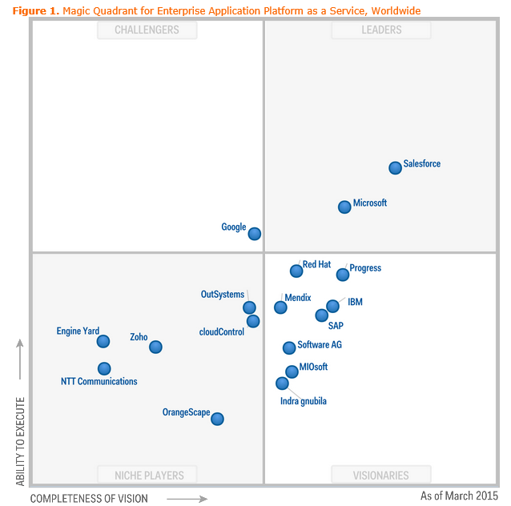
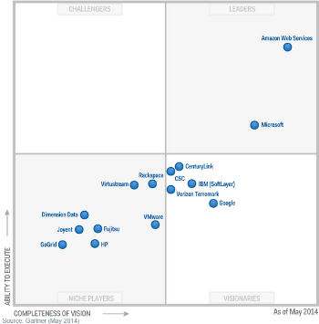
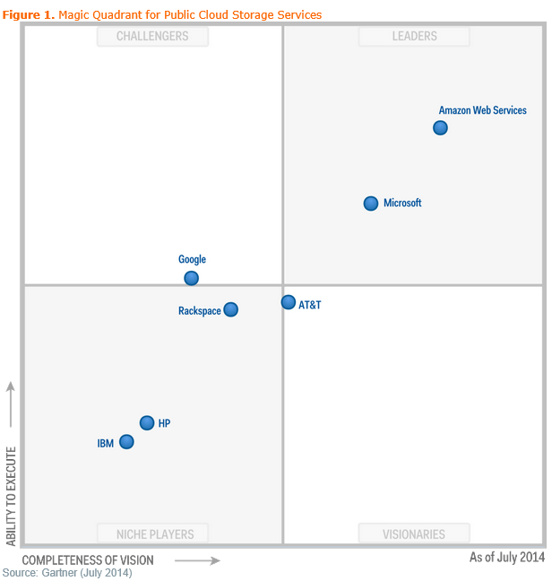
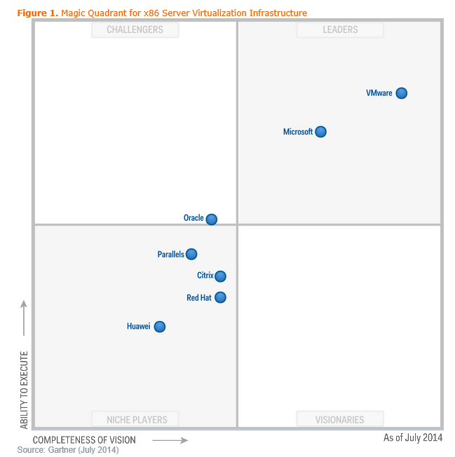
Market Endorsement
Gartner Magic Quadrant for Enterprise Application Platform as a Service(PaaS)
Gartner Magic Quadrant for Cloud Infrastructure as a Service(IaaS)
Gartner Magic Quadrant for Public Cloud Storage Services
Gartner Magic Quadrant for Virtualization

Slide 9

Datacenters Today A contemporary view
Service Provider Cloud
Private Cloud
VMs
Application
Server OS
VMs
Application
Hypervisor
Server OS
Public Cloud
Hypervisor
On-Premises Datacenter
Off-Premises Datacenter

Slide 10
Azure StorSimple
Azure in Open
Azure Government
Azure SQL Database
Rights Management (RMS)
Azure API Management
Azure Site Recovery
Azure Automation
Instance Level Public Ips
Azure Redis Cache
Azure Batch
Azure Marketplace
Azure Data Factory
Stream Analytics
Event Hubs
Operational Insights
Premium Storage
Virtual Machine Converter 3.0
Cloud Platform System (CPS)
Antimalware for Cloud Services and VMs
Identity Manager vNext
Analytics Platform System (APS)
Visual Studio Community 2013
Visual studio 2015 Preview
.NET 2015
Azure RemoteApp
Azure AD Basic
SSD-based instances for Microsoft Azure VMs and Cloud Services
Azure SQL Database Auditing
Live Channels for Azure Media Services
AAD Application Proxy
New experiences in Power BI
Azure DocumentDB
Azure Search
HDInsight for Storm Public Preview & GA
Azure Zone Redundant Storage
HDInsight for Hbase
WSSC vNext tech preview
Content Protection pub preview
Intune - Nov update and Dec update
Azure AAD premium features
Multi-Factor Auth enhancements
Cloudera and Hortonworks on clustered Azure VMs
Azure Instance level IP
Azure Role Based Access Controls
VPN support pub preview
TiP Testing pub preview
Azure AD Workday A148 Integration
Azure Standard SSG
ExpressRoute S2S, P2S GA
Azure Multiple NICs
Azure Networking Appliances
Azure Traffic Manager Nested policies
Azure VM Image Gallery expansion
Azure Vnet
Azure Web Jobs
VSO datacenter expansion
VSO REST Hooks pub preview
Australia datacenter
Forced Tunneling
WSSC Azure Packs
Azure G-Serves Instances
Azure Key Vault
Drivers for SQL Server
MDM for Office 365 public preview and GA
Azure Media Services Content Protection
Azure Mobile Engagement
Node.js Tools for Visual Studio
Visual Studio 2013 updates
Auto-HA for SQL Server VM
Auto-Patching and Backup for SQL Server VMs
Azure SQL Database Increased Compatibility
Azure AD Connect Health pub preview
Azure AD MFA Per App / Conditional access pub preview
Azure RMS controlled user deployment
Azure RMS departmental templates pub preview
Azure Site Recovery SAN Replication
ASP.NET 5 Preview
Azure SDK 2.5.1
Team Foundation Server 2015 preview
Azure Machine Learning GA
Azure HDInsight for Linux Pub Preview
Azure HDInsight Support for Hadoop 2.6 pub preview
Azure SQL Database security feature - Data Masking pub preview
Azure SQL Database security features - Encryption
Azure SQL Database security features - Row Level security
Azure AD: API for SIEM
Microsoft Intune monthly updates
Remote Desktop Client for Windows Phone 8.1
Azure App Service
Azure CDN Integration
Azure Media Encoder Premium
Azure AD Premium & Basic in CSP
Azure IoT Suite
Windows Server Containers
Hyper-V Containers
Windows Server Nano Server
Azure Media Player GA
Azure Service Fabric
Azure IoT Suite
Azure Site Recovery: Protect VMWare and Physical Servers in Public Preview
Azure Backup Generally Available
Azure API Management Premium simplifies high availability and massive scale for APIs
ExpressRoute for Office 365
Azure Active Directory Dynamic Membership For Groups
Automatic Password Change for Social Media Shared Accounts
Compute-Intensive A10 and A11 Virtual Machine Instances
Remote Desktop app for Windows Phone support for Gateway and Remote Resources
Informatica Cloud Agent availability in Linux and Windows Virtual Machines
Azure DocumentDB Hadoop Connector
Azure HDInsight support for more VM sizes
Enterprise-Grade Array-Based Replication and Disaster Recovery with ASR and System Center GA
500+
New releases in
the last 12 months
Notes:
112

Slide 11




























































Virtual Machines
Cloud Services
App Services
Windows Phone
iOS
Android
Nokia X
Windows Store
iOS
Android
HTML5/JS
GALLERY
DEPLOY
YOUR
CODE
Load Balancer
Gallery
Load Balancer
VIRTUAL MACHINES
Windows
WEB ROLE
INSTANCES
Load Balancer
Linux
APP
INSTANCES
VIRTUAL
NETWORK
QUEUE
SQL
CACHE
TYPE X
TYPE Y
APP
TYPES
…
API APP
LOGIC APP
WEB APP
MOBILE APP
STORAGE BLOBS / FILES (Virtual Disks)
Database
Blobs/Files
Tables/NoSQL
API MARKETPLACE…
STORAGE SOLUTIONS
COMPUTE
NETWORKING
IDENTITY & ACCESS
MEDIA & CDN
Virtual
Machines
Cloud
Services
Batch
Scheduler
Remote App
Virtual
Network
Express
Route
Traffic
Manager
Active
Directory
Multi-Factor
Authentication
Media
Services
Content Delivery
Network (CDN)
Get full control over a server in the cloud and maintain it as your business requires.
Managed Virtual Machines with specific web and worker roles that are stateless
For running large scale parallel and high performance computing (HPC) applications
Create jobs that run reliably on simple or complex schedules to invoke any type of service.
Access Windows apps that run within the Service on VM’s from any device and any location.
Provision and manage VPNs in Azure and securely link to your on-premises IT infrastructure.
Connect on-premises and cloud data centers directly through dedicated, non-internet lines.
Load-balance incoming global traffic across multiple services running in multiple data centers.
Identity and access management for cloud applications and ability to link to on-premises Server AD.
Safeguard access to data and apps with additional physical layer of security control.
Range of services that support video on-demand and live streaming workflows.
Cache content for your apps at 100’s of edge locations to improve user experiences.
WEB & MOBILE
ANALYTICS
Web Apps
Mobile
Apps
API
Apps
Logic
Apps
API
Management
Notification
Hubs
HDInsight
Machine
Learning
Stream
Analytics
Data
Factory
Event
Hubs
Mobile
Engagement
Managed web platform, get started for free and scale as you go using many tools/ languages.
Add backend capabilities to mobile apps, with native client support on most device platforms.
Create and surface your app logic as APIs for other services and apps to consume.
Build/execute business processes by linking your own custom API’s with an API Gallery/Marketplace
Publish and Manage APIs to developers, partners and employees securely and at scale.
Deliver millions of cross platform push notifications from any application backend, anywhere.
Big Data (based on Apache Hadoop) analytics that integrate easily with Microsoft Office.
Mine historical data with compute power to predict future trends or behavior.
Process data streams in real-time to discover and react to trends.
Ingest data from multiple sources to combine into a cloud based Data Warehouse.
Ingest, persist, process millions of events per second from millions of devices.
Ingest, persist, process millions of events per second from millions of devices.
STORAGE & BACKUP
DATA
DEVELOPER SERVICES
Storage Blobs
& Files
Backup
Import/Export
Site
Recovery
StorSimple
SQL
Database
DocumentDB
Redis
Cache
Search
Tables
Visual Studio
Online
Application
Insights
Store binary application data and web content – store for dedicated and shared virtual disks for VM’s
Managed service that handles backup/restore of Windows Server machines/backup agent.
For massive data transfer – ship encrypted disks to move data in/out of blob storage.
Coordinate replication and recovery of System Center private clouds
Automated, policy driven solution to extend on-premises primary storage for backup / DR.
Managed relational database service with high availability and selectable performance levels.
Store/retrieve millions of JSON objects from a highly scalable NoSQL document database.
Make applications scale and be more responsive under load by keeping data closer to app logic.
Managed, scalable search service for your apps, create tunable search results and ranking models.
Massive scale for semi-structured key/value type data in this schema-less NoSQL store.
Store code, plan and track projects, build, deploy and test apps in the cloud collaboratively.
Analyze app usage, availability and performance to detect issues and solve problems proactively.
HYBRID INTEGRATION
MANAGEMENT
COMMERCE
Storage
Queues
Biztalk
Services
Hybrid
Connections
Service
Bus
Automation
Portal
Key
Vault
Operational
Insights
Store /
Marketplace
VM Depot
Simple message queue for application de-coupling architecture for scale out.
Build EDI and Enterprise App Integration (EAI) solutions in the cloud.
Connect apps in Azure with on-premises resources without a VPN or dedicated line.
Messaging capabilities (pub/sub, queues) and on-premises to cloud connectivity solution.
Run durable PowerShell scripts to automate frequent, long running, complex Azure tasks.
Web based experience to provision, control and monitor all Azure services.
Safeguard and control keys and secrets in cloud scale hardware security modules.
Analyze and troubleshoot on-premises IT infrastructure without using instrumented code.
Find and manage other services provided by third parties.
Find free open source VM images that you can download and run in Azure Virtual Machines.

Slide 12
11 Categories
Compute
Web & Mobile
Data & Storage
Analytics
Internet of Things
Networking
Media & CDN
Hybrid Integration
Identity & Access Management
Developer Services
Management

Slide 13
Compute
Virtual Machines
Provision Windows and Linux Virtual Machines and applications in minutes
Cloud Services
Create highly available, infinitely scalable cloud applications and APIs
Batch
Run large-scale parallel and batch compute jobs
RemoteApp
Deploy Windows client apps in the cloud, run on any device

Slide 14
Web & Mobile
App Service
Create web and mobile apps for any platform and any device
Web Apps
Quickly create and deploy mission critical Web apps that scale with your business
Mobile Apps
Build and host the backend for any mobile app
Logic Apps
Automate the access and use of data across clouds without writing code
API Apps
Easily build and consume Cloud APIs
http://weblogs.asp.net/scottgu/announcing-the-new-azure-app-service

Slide 15
Web & Mobile
API Management
Publish APIs to developers, partners and employees securely and at scale
Notification Hubs
Scalable, cross-platform push notification infrastructure
Mobile Engagement * 11/01
Maximize app usage, retention and monetization

Slide 16
Data & Storage
SQL Database
Managed Relational SQL Database-as-a-service
DocumentDB
Managed NoSQL document database-as-a-service
Redis Cache
High throughput, low latency data access to build fast and scalable applications
Storage (table, blob, queue)
Durable, highly available and massively scalable cloud storage
StorSimple
Hybrid cloud storage for enterprises, reduces costs and improves data security
Azure Search
Fully-managed search-as-a-service

Slide 17
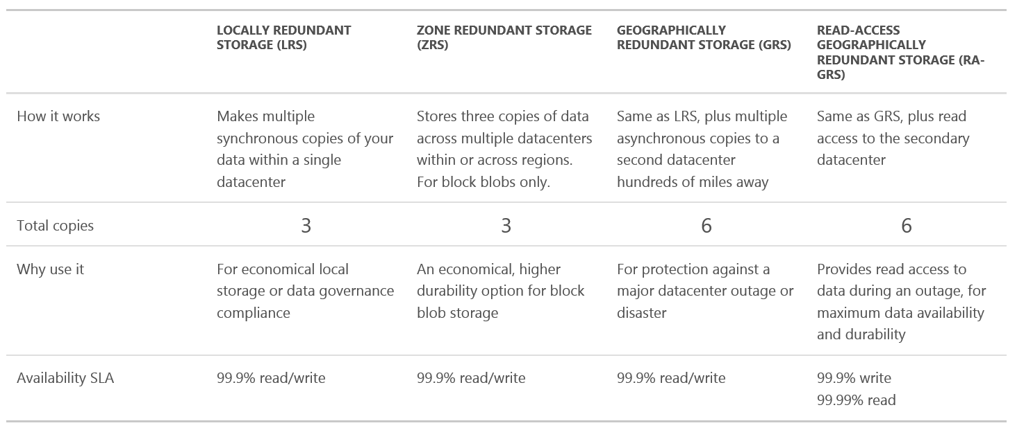
Aside… Storage (table, blob, queue)

Slide 18
Analytics
HDInsight
Provision managed Hadoop clusters
Machine Learning
Powerful cloud-based predictive analytics
Data Factory
Orchestrate and manage data transformation and movement
Event Hubs
Ingest, persist, and process millions of events per second
SQL Data Warehouse*
Elastic data warehouse as a service with enterprise class features

Slide 19
Analytics
Data Lake**
Store and analyze data of any kind and size
Data Catalog*
Get more value from your enterprise data assets
Stream Analytics
Real-time stream processing

Slide 20
Internet of Things - Azure IoT Suite
IOT Hub
Connect, monitor, and control millions of IoT assets
Event Hubs
Receive telemetry from millions of devices
Notification Hubs
A scalable, mobile-push notification engine for quickly sending millions of messages.
Power BI
Transform data into rich visuals
& Machine Learning, Stream Analytics

Slide 21
Networking
Virtual Network
Provision private networks, optionally connect to on-premises datacenters
ExpressRoute
Dedicated private network fiber connections to Azure
DNS*
Host your DNS domain in Azure
VPN Gateway
Establish secure, cross-premises connectivity

Slide 22
Networking
Traffic Manager
Load balance incoming traffic for high performance and availability
Application Gateway
Highly scalable websites with HTTP load balancing and delivery control
Load Balancer
Deliver high availability and network performance to your applications

Slide 23
Media & CDN
Media Services
Encoding
Azure Media Player
Media Indexer
Content Protection
Live and On-Demand Streaming
CDN
Deliver content to end-users through a robust network of global data centers

Slide 24
Hybrid Integration
BizTalk Services
Seamlessly integrate the enterprise and the cloud
Service Bus
Connect across private and public cloud environments
Backup
Simple and reliable server backup to the cloud
Site Recovery
Orchestrate protection and recovery of private clouds

Slide 25
Identity & Access Management
Azure Active Directory
Synchronize on-premises directories and enable single sign-on
Azure Active Directory B2C*
Consumer identity and access management in the cloud
Azure Active Directory Domain Services
Your domain controller as a service
Multi-Factor Authentication
Safeguard access to your data and apps with an extra level of authentication

Slide 26
Developer Services
Visual Studio Online
Plan, build and ship software, all from one place
Visual Stuido Application Insights
Detect and solve problems to continuously improve web apps

Slide 27
Management
Scheduler
Run your jobs on simple or complex recurring schedules
Automation
Simplify cloud management with process automation
Operational Insights
Collect, search and visualize machine data from on-premises and cloud
Key Vault
Safeguard and maintain control of keys and other secrets

Slide 28

Ask yourself…

Slide 29

Is this the right tool for the job?

Slide 30



Scale up vs scale out?

Slide 31


Who is going to maintain it?
Packaged Software
Infrastructure
(as a Service)
Platform
(as a Service)
Software
(as a Service)
You manage
Applications
Applications
Applications
Applications
Data
You manage
Data
Data
Data
Runtime
Runtime
Runtime
Runtime
Managed by vendor
You manage
Middleware
Middleware
Middleware
Managed by vendor
Middleware
O/S
O/S
O/S
O/S
Virtualization
Virtualization
Managed by vendor
Virtualization
Virtualization
Servers
Servers
Servers
Servers
Storage
Storage
Storage
Storage
Networking
Networking
Networking
Networking
Your Car
Rental Car
Taxi

Slide 32
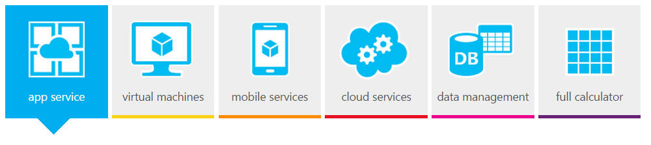
How much is it going to cost
Azure Pricing Calculator
http://azure.microsoft.com/en-us/pricing/calculator/

Slide 33

Choices

Slide 34
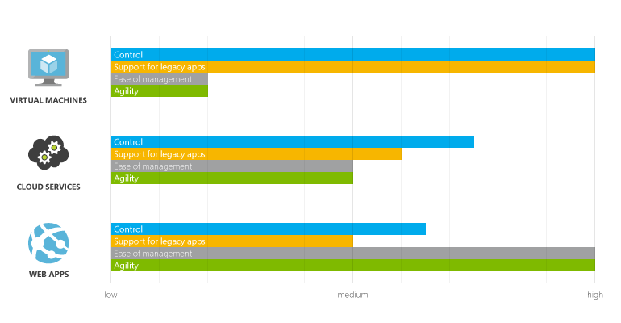
Azure Websites, Cloud Services, and Virtual Machines comparison
http://azure.microsoft.com/en-us/documentation/articles/choose-web-site-cloud-service-vm/

Slide 35
Structured Data at rest
Storage Blobs
Storage Tables
Relational Storage (SQL Server PaaS or IaaS)
Document DB

Slide 36
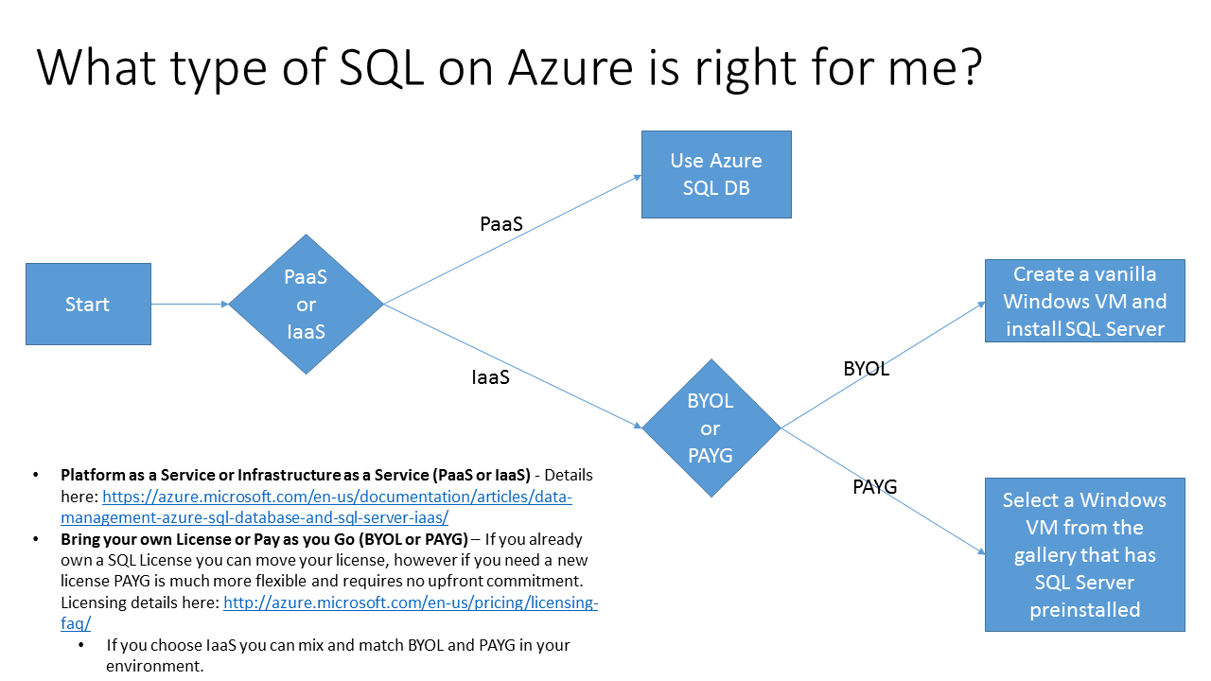
Relational Data
http://blogs.msdn.com/b/azuregov/archive/2015/08/31/what-type-of-sql-on-azure-is-right-for-me.aspx

Slide 37

Azure Queues and Service Bus Queues
https://msdn.microsoft.com/en-us/library/azure/hh767287.aspx

Slide 38
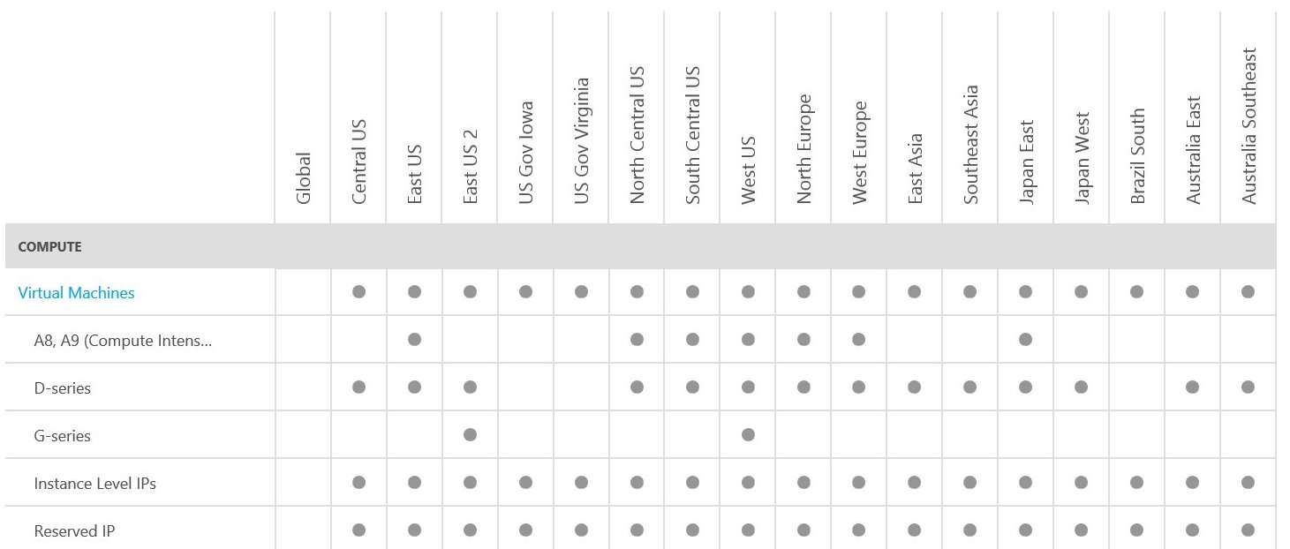
Azure Services by region
Details @ http://azure.microsoft.com/en-us/regions/#services

Slide 39
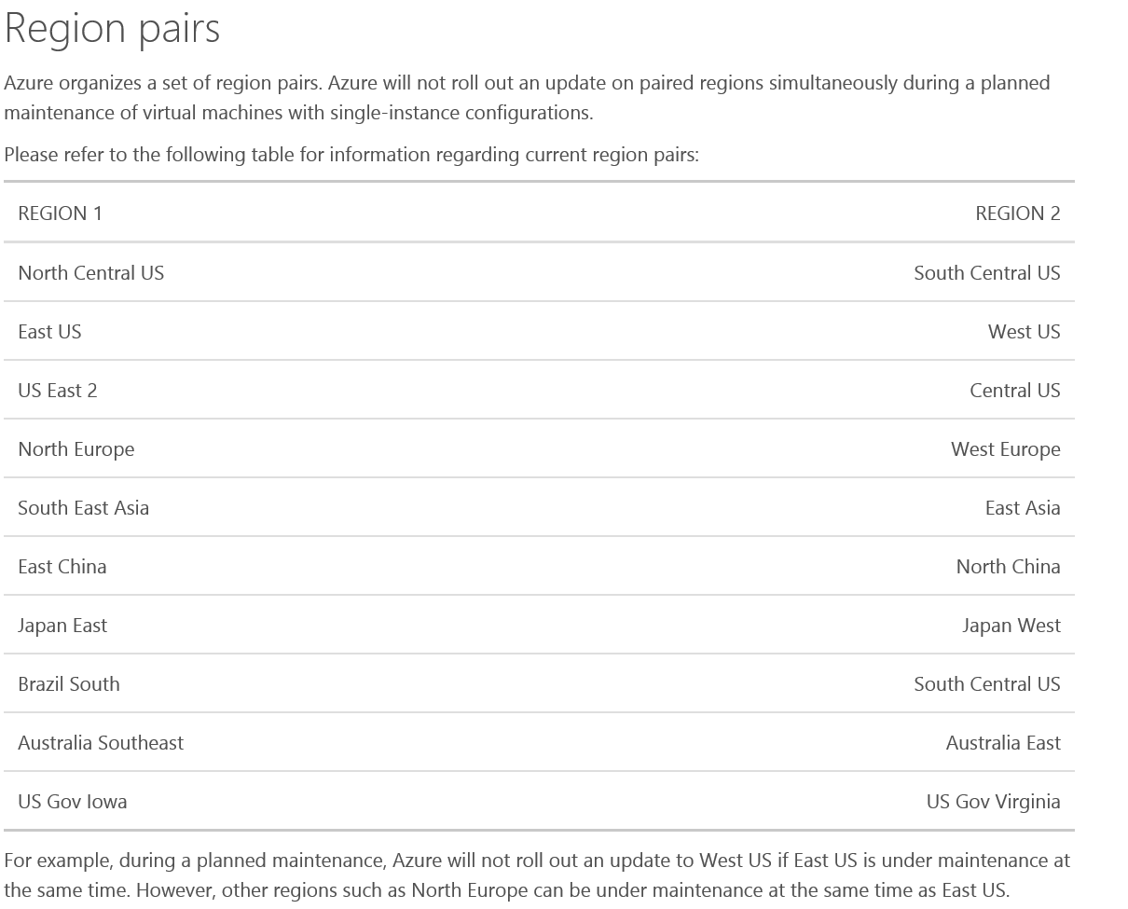
What is a Buddy Region?

Slide 40
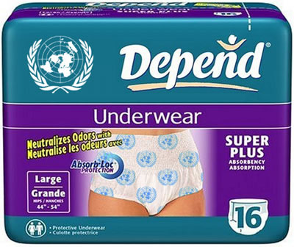

Slide 41
Shawn’s Top Tips

Slide 42

Know your limits
http://azure.microsoft.com/en-us/documentation/articles/azure-subscription-service-limits/

Slide 43

Load Test
VSO Load Test - https://www.visualstudio.com/en-us/get-started/load-test-your-app-vs.aspx
Penetration Test Approval Form - https://security-forms.azure.com/penetration-testing

Slide 44

Don’t reinvent the wheel
P&P Perf: https://github.com/mspnp/performance-optimization
P&P Best Practices: https://github.com/mspnp/azure-guidance
Design Patterns: http://msdn.microsoft.com/en-us/library/dn589799.aspx

Slide 45

Stage Deployments
Cloud Services - http://azure.microsoft.com/en-us/documentation/articles/cloud-services-nodejs-stage-application/
WebApps - http://azure.microsoft.com/en-us/documentation/articles/web-sites-staged-publishing/

Slide 46

Telemetry is key
http://blogs.msdn.com/b/kwill/archive/2014/12/02/windows-azure-diagnostics-upgrading-from-azure-sdk-2-4-to-azure-sdk-2-5.aspx

Slide 47

Its better with two
http://azure.microsoft.com/en-us/support/legal/sla/

Slide 48
Enter the 9’s
Availability % | aka | Potential Minutes Downtime/Month (30 days)
90% | 1 nine | 72 hours
99% | 2 nines | 7.2 hours
99.9% | 3 nines | 43.2 minutes
99.99% | 4 nines | 4.32 minutes
99.999% | 5 nines | 25.9 seconds
99.9999% | 6 nines | 2.59 seconds

Slide 49
SLAs
Microsoft’s commitments for uptime and connectivity for Microsoft Online Services
Financially backed
Calculated Monthly
Azure Service | SLA | Potential Minutes Downtime/Month (30 days)
Compute (VMs) | 99.95% | 21.6
SQL Database | 99.99% | 4.32
Storage | 99.90% | 43.2
Details @ http://azure.microsoft.com/en-us/support/legal/sla/

Slide 50



Composite SLAs
Example – 3 Tiers
Azure Traffic Manager - 99.99% SLA
Web Tier running on 2 VMs in an Availability Set – 99.95% SLA
DB Tier running on 2 VMs in an Availability SET - 99.95% SLA
Total SLA – 99.89% or 47 minutes per 30 day month
99.99% * 99.95% * 99.95% = 99.89%

Slide 51
Planned maintenance for Azure virtual machines
Memory-preserving updates
Guest VM is “paused”, update applied to host, guest is “resumed” and the clock synchronized. Typically around a 30 second blip.
Regular updates of multi-instance VMs
Guest VM is shut down, update is applied to host, host is rebooted, guest is restarted.
48-hour advanced notification for planned maintenance of virtual machines in the multi-instance configuration
Details @ https://azure.microsoft.com/en-us/documentation/articles/virtual-machines-planned-maintenance/

Slide 52

http://www.microsoft.com/en-us/server-cloud/roadmap/recently-available.aspx

Slide 53
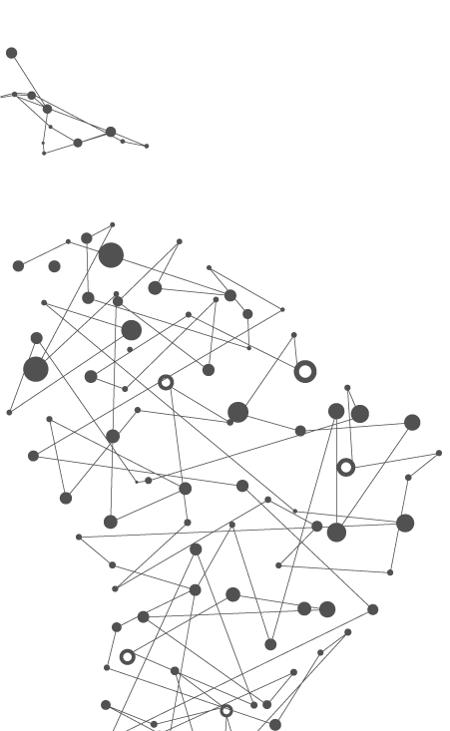

Azure Service Fabric High-control distributed computing framework
Foundation technology we use internally
Create stateless + stateful microservices
Enable Hyper-scale, self-healing, orchestration
Windows Server + Linux
Multi-cloud support

Slide 54
Microsoft Azure Service Fabric A platform for reliable, hyperscale, microservice-based applications
Microservices
High Availability
Data Partitioning
Service Fabric
Health Monitoring
Container Orchestration & lifecycle management
Hybrid Operations
Self-healing
Simple programming models
High Density
Rolling Upgrades
Low Latency
Placement Constraints
Replication & Failover
Stateful services
Fast startup & shutdown
Load balancing
Hyper-Scale
Automated Rollback
Windows
Server
Linux
Windows
Server
Linux
Azure
Hosted Clouds
Windows
Server
Linux
Private Clouds

Slide 55

Service Fabric cluster with microservices
App1
App2

Slide 56

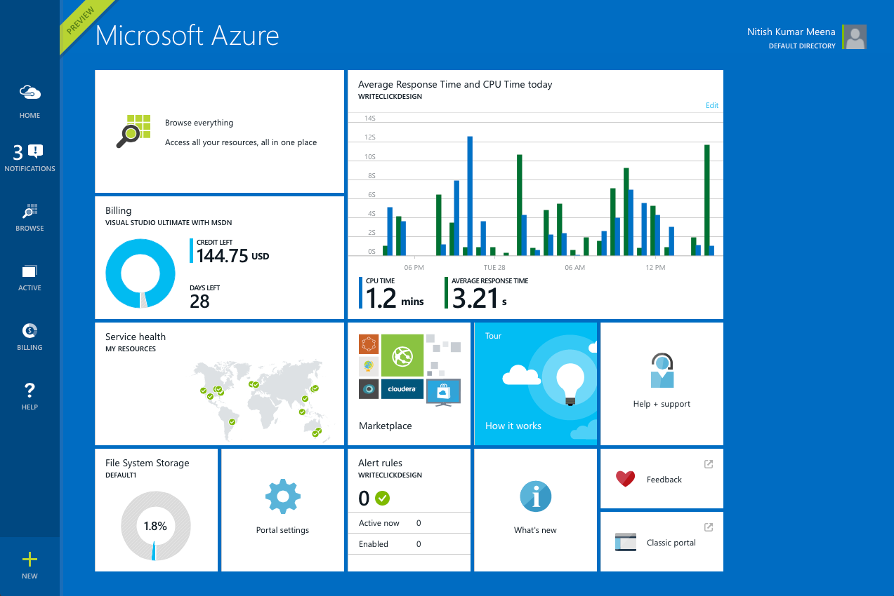
Get started
Visit azure.microsoft.com

Slide 57

Thank you! Your Feedback is Important
Rate My Talk & Download Slides!
http://bit.ly/RateShawnsTalk
(case sensitive)
Contact Information
Email: shawn@shawnweisfeld.com
Blog: http://www.shawnweisfeld.com
Twitter: @shawnweisfeld

Slide 58

© 2014 Microsoft Corporation. All rights reserved. Microsoft, Windows, Windows Vista and other product names are or may be registered trademarks and/or trademarks in the U.S. and/or other countries.
The information herein is for informational purposes only and represents the current view of Microsoft Corporation as of the date of this presentation. Because Microsoft must respond to changing market conditions, it should not be interpreted to be a commitment on the part of Microsoft, and Microsoft cannot guarantee the accuracy of any information provided after the date of this presentation. MICROSOFT MAKES NO WARRANTIES, EXPRESS, IMPLIED OR STATUTORY, AS TO THE INFORMATION IN THIS PRESENTATION.

